Slide 1

ALY 6040 – Data Mining Applications Final Project Presentation
Group 6 -
Rohith Krishnamurthy
Likith Garimella
Maheswar Veerlanka
Likith Sai Challa

Slide 2

Comprehensive Analysis of Banking Loan Data and Predictive Model Evaluation

Slide 3
Introduction
Purpose: Formulate strategies for denying loans, reducing loan amounts, and setting higher interest rates for risky applicants.
Target Audience:
Bank Agents: To assist in loan applicant evaluation and risk analysis.
Loan Applicants: For gaining insights into the current status of their loan eligibility.
User-Friendly Interface: The app offers an easy-to-use interface, allowing users to input specific financial details and receive instant loan eligibility estimates.

Slide 4
Data Overview
Data Source: The "Banking Loan Case Study Data" from Kaggle presents a comprehensive dataset for in-depth analysis, comprising 39,717 rows and 111 columns.
Rich Feature Set: Includes comprehensive details such loan distribution, borrower profiles, and overarching lending trends within the banking domain.
Data Reliability: The dataset is sourced from reliable records, ensuring accuracy and dependability of predictions.

Slide 5

Analytical Approach
There are 31,534 fully paid loans and 5,203 charged off
Label Encoding: The 'loan_status' column is label-encoded, transforming the textual categories into a numeric format (1 for 'Fully Paid', 0 for 'Charged Off') for machine learning purposes.
Feature Mapping: For categorical variables like 'home_ownership', 'purpose', and 'state', custom mapping is applied to convert text values to numeric codes, facilitating their use in predictive modeling.
SMOTE for Class Balancing: The SMOTE (Synthetic Minority Over-sampling Technique) algorithm is applied to the training data to balance the classes, addressing the issue of class imbalance by oversampling the minority class in the training set.

Slide 6

Models Performed – Loan Status
Model Exploration Strategy: To ensure the most effective model was selected for our application, a range of machine learning models were evaluated, each known for their strengths in regression tasks.
Logistic Regression: As a baseline model, Linear Regression was initially used to establish a benchmark for performance.
Decision Tree Classifier: Experimented with Decision Trees to understand feature relationships and for their interpretability.
Random Forest Classifier: Chosen for its ability to handle complex datasets and provide more accurate predictions. It's an ensemble of Decision Trees, which reduces the risk of overfitting and improves prediction accuracy.
XGBoost Classifier: Tested for its advanced capabilities in handling large datasets and its efficiency in performance.

Slide 7
Models Performed – Interest Rate
Model Exploration Strategy: To ensure the most effective model was selected for our application, a range of machine learning models were evaluated, each known for their strengths in regression tasks.
Random Forest Regressor: Experimented with Random Forest Regressor for its robust performance and ability to capture nonlinear relationships.
XGBoost Regressor: Tested XGBoost Regressor due to its regularization to prevent overfitting and ability to handle sparse data.
Elastic Net Regressor: Evaluated Elastic Net Regressor for its combined regularization and ability to perform variable selection.
GridSearchCV with Elastic Net: Performed hyperparameter tuning on Elastic Net using GridSearchCV to optimize model performance.

Slide 8

Model Selected
Model Evaluation: Each model was rigorously tested using metrics like Mean Squared Error (MSE) and R² Score. This process ensured the selection of the model that best captured the nuances of our data.
Final Selection: (Loan Status) The Random Forest Regressor was selected due to its superior performance, robustness against overfitting, and ability to handle a mix of numerical and categorical data effectively.
Final Selection: (Interest Rate) The XGBRegressor model was selected due to its strong predictive accuracy on the test set, computational efficiency in training, and inbuilt regularization to prevent overfitting.

Slide 9

Model Performance
Performance Metrics: The model's effectiveness is demonstrated through key metrics:
Target Variable | Mean Squared Error (MSE): | R-Squared (R²) Score:
Loan Status | 0.2142 | 0.7904
Interest Rate | 2.1126 | 0.8469

Slide 10
App Overview
User-Friendly Design: The app is designed for ease of use, allowing both bank agents and individuals to input data effortlessly.
Interactive Features:
Modifiable Inputs: Users can input key financial details such as.
Instant Predictions: Upon entering the financial details, users can click the “Submit" button to receive instant predictions.
Underlying Process: The app processes the inputs through the trained Random Forest model, considering both user-provided and default feature values

Slide 11
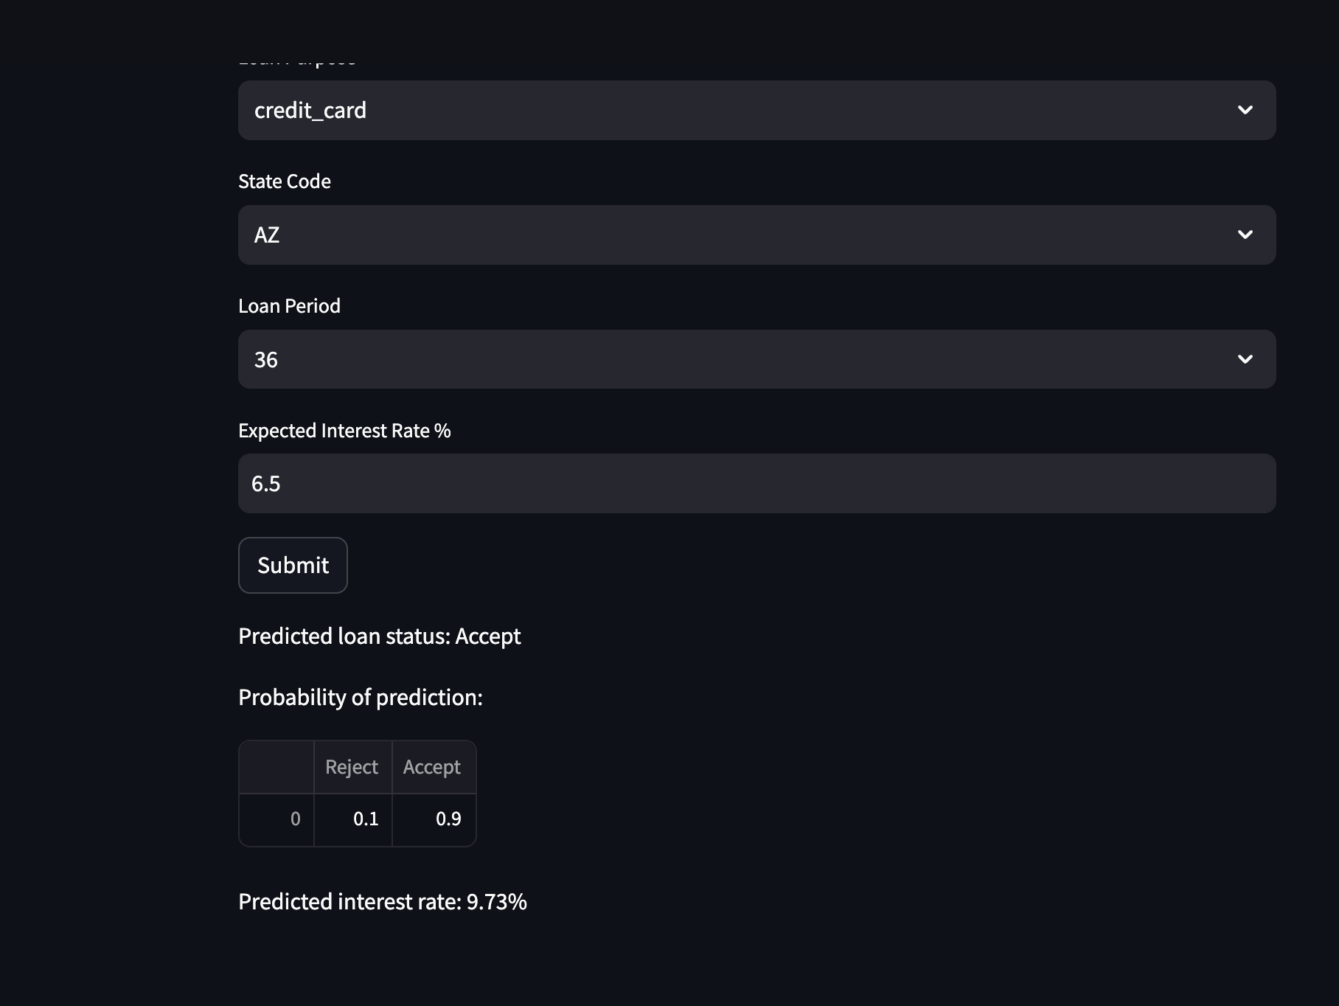
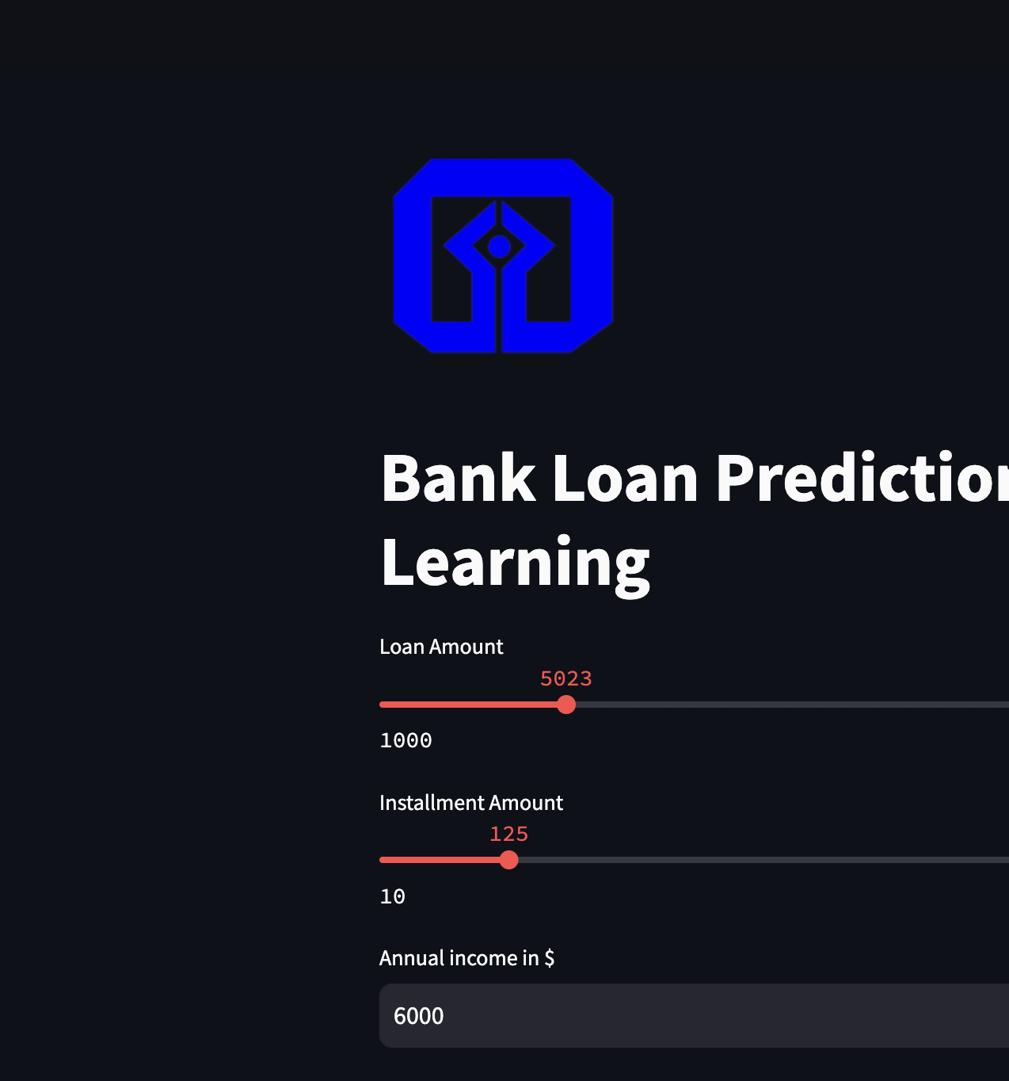

Slide 12

Recommendations
Incorporate additional features identified as predictive of default risk such as number of credit inquiries, number of open accounts, and past bankruptcy flags. Expanding feature set can improve model accuracy.
Track model performance over time with new data and retrain periodically. Set triggers to retrain if metrics like accuracy or AUC fall below thresholds.
Build in explainability using methods like SHAP values to understand feature importance and derive business insights.

Slide 13

Conclusion
Our study underscores the complexity of lending and the necessity of leveraging data analytics for risk management and customer engagement.
Implementing targeted loan products and automating data processes are key to enhancing financial stability and operational efficiency.
Continual model optimization and fostering a data-centric culture within lending institutions are vital for adapting to the dynamic financial landscape.

Slide 14

References
Scikit-learn developers. (2022). sklearn.ensemble.GradientBoostingClassifier. Scikit-learn.
Scikit-learn developers. (2022). sklearn.tree.DecisionTreeClassifier. Scikit-learn.
Prediction of Default Risk in Peer-to-Peer Lending Using Structured and Unstructured Data Jei Young Lee https://files.eric.ed.gov/fulltext/EJ1279989.pdf
Predicting Possible Loan Default Using Machine Learning (https://www.analyticsvidhya.com/blog/2022/04/predicting-possible-loan-default-using-machine-learning/)
Loan Defaulter Predication Case Study (https://medium.com/nerd-for-tech/loan-defaulter-predication-case-study-a4cd457273be)
https://github.com/likith2201/BankLoanCaseStudy_Project

Slide 15

Thank you

